Slide 1

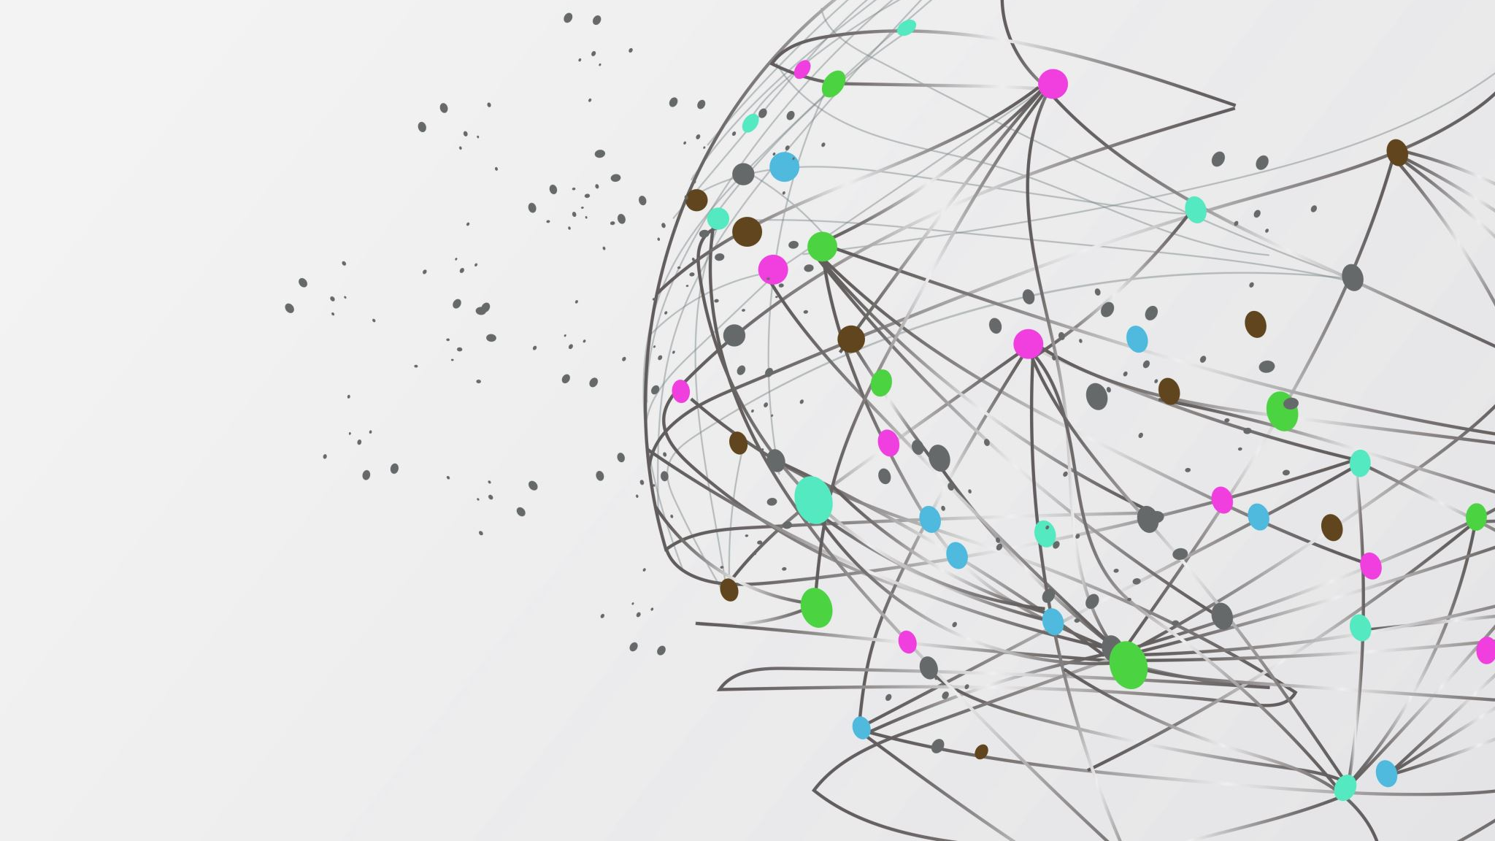
Methods

Slide 2
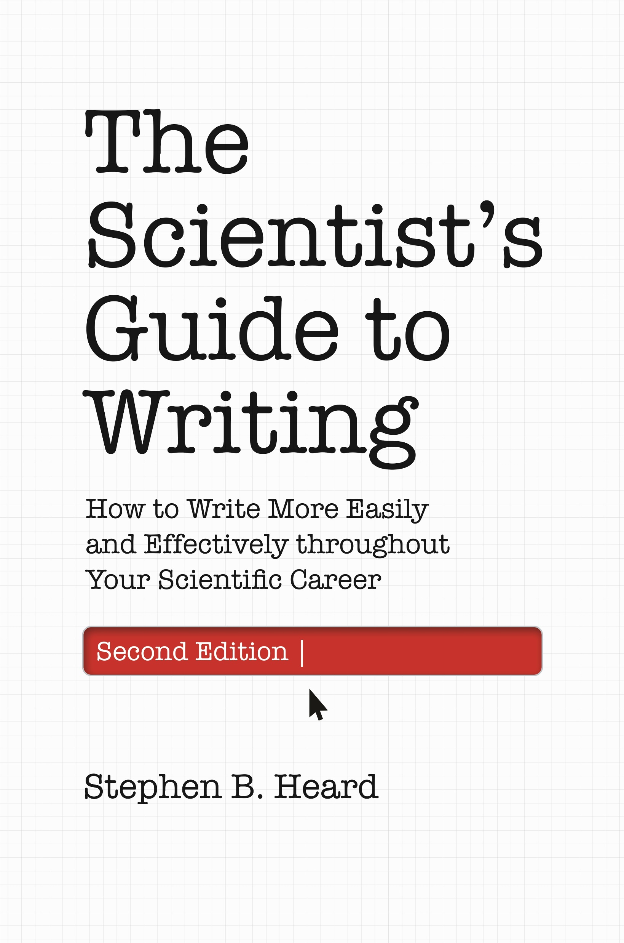

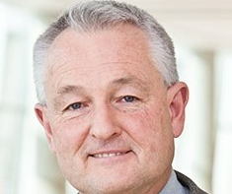
Sources and Inspiration
Stephen Heard, UNB, author of The Scientist Guide to Writing
Irving H. Zucker, UNMC
& Myron Toews, UNMC

Slide 3

Why
Assess results for:
Meaning
Believability
Replicate experiments

Slide 4
Where
Stand-alone
Journal Article
Methods journal
https://www.protocols.io/
IMRaD – After Introduction
The End, After Discussion
Online supplements
Figure legends
Specifics for individual figures

Slide 5
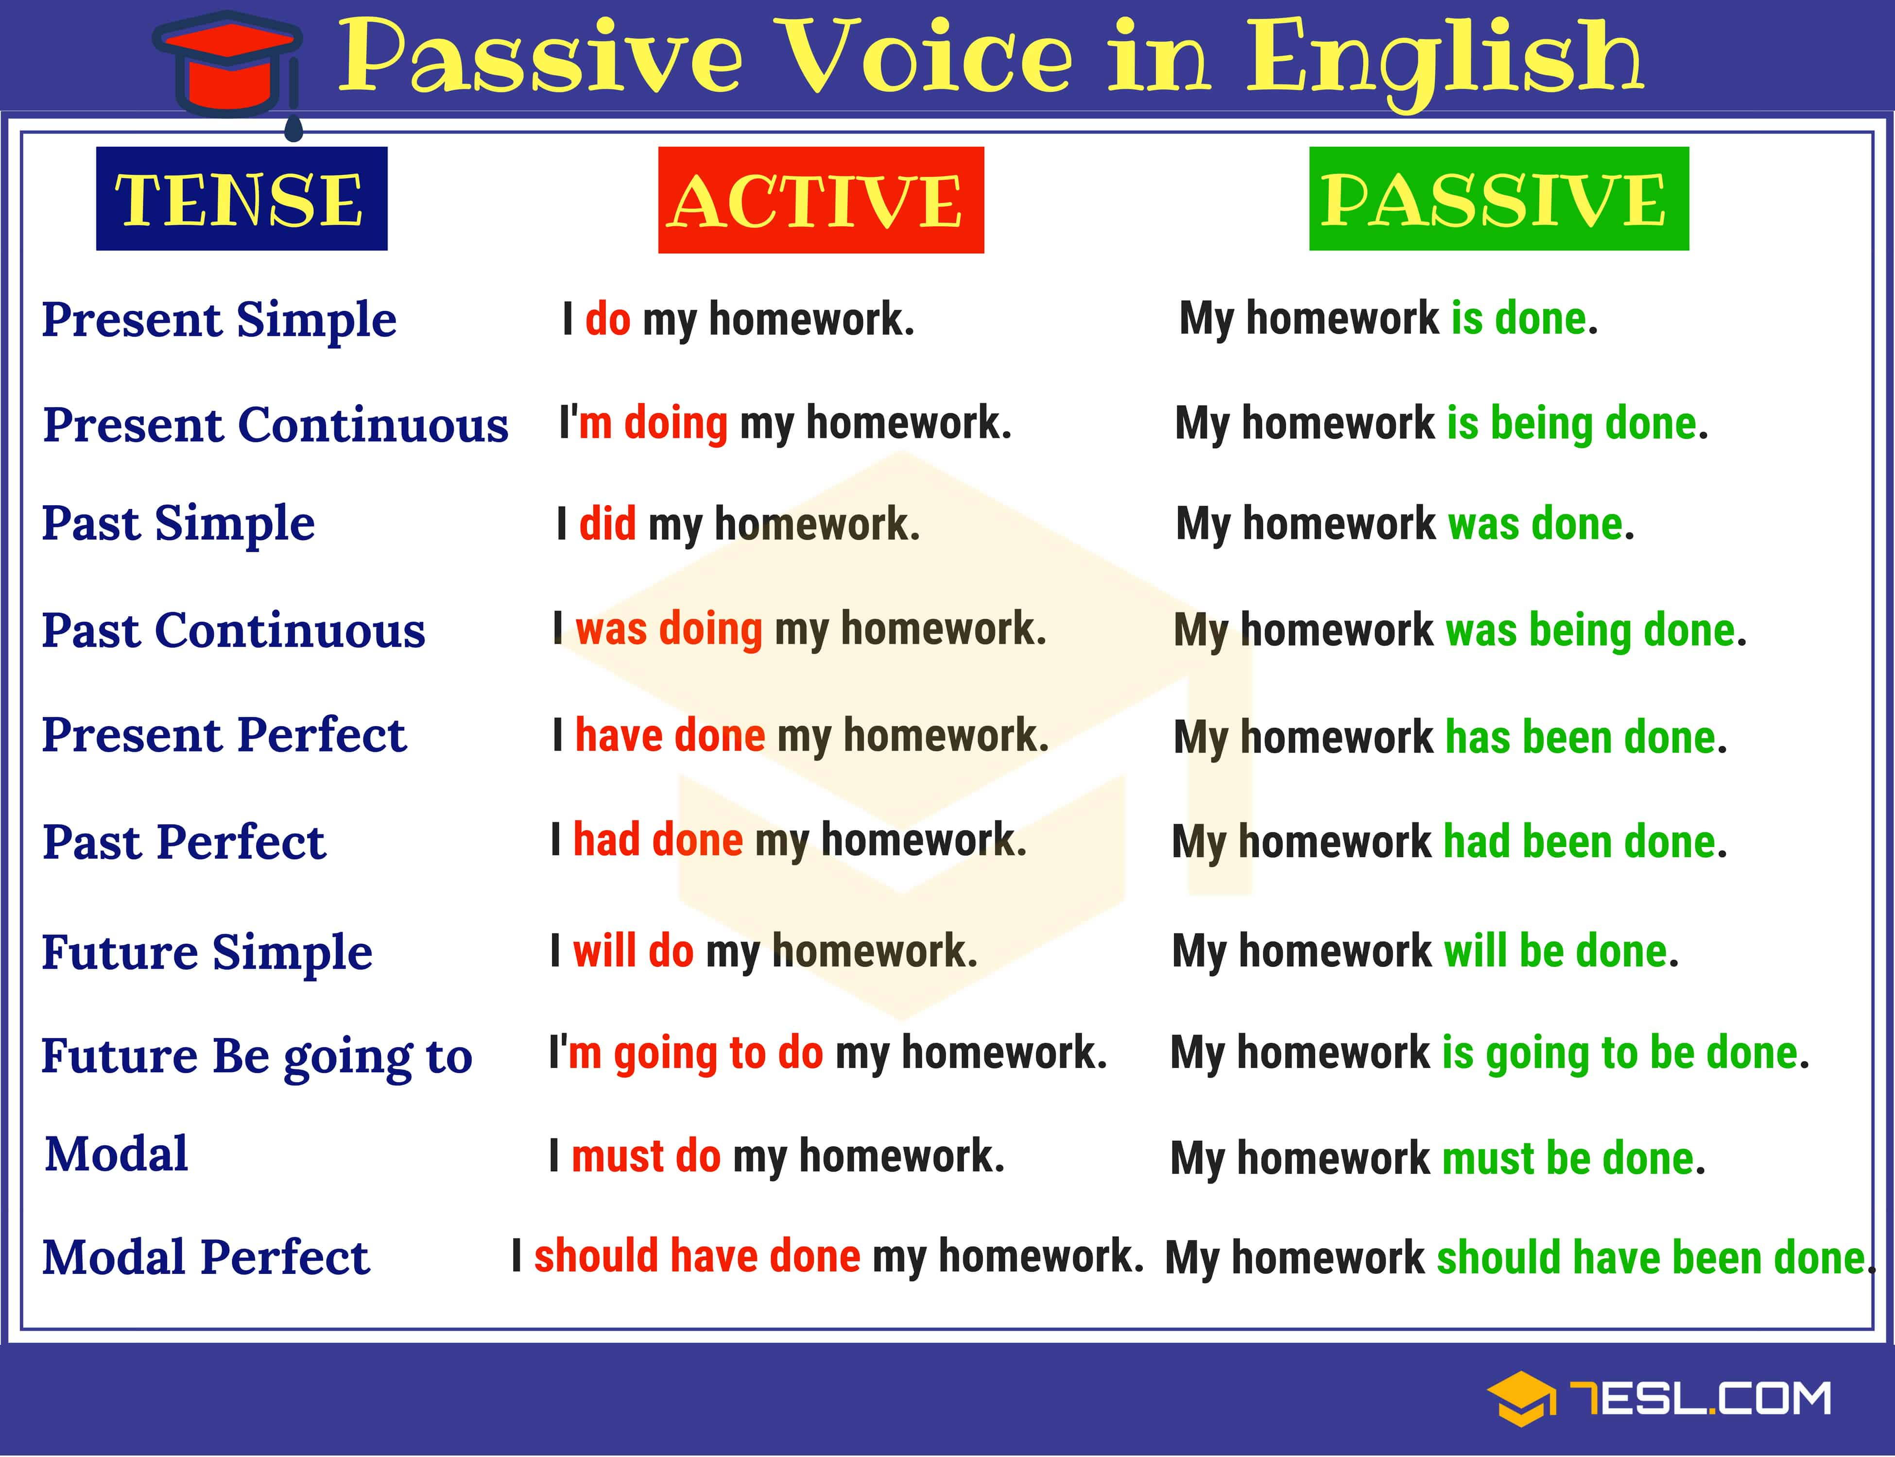
How
Past tense
Active voice
?!? First person !?!
Notes:
https://7esl.com/passive-voice/

Slide 6
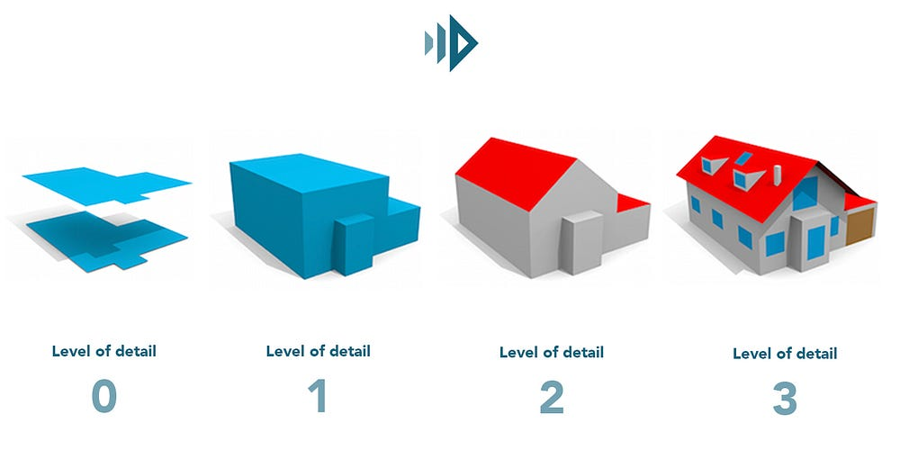

What - Detail
Amount of Detail | Purpose
Little | establish your credibility
Medium | understand your results
Lots | repeat your work
Notes:
https://3dbuildings.medium.com/how-building-data-works-level-of-detail-e9bad0b61baa

Slide 7
What - Detail
Amount of Detail | Situation
Extensive | New method
More | First use of method in lab
Medium | Slight modifications to method described somewhere else
Minimal | Very common/simple method
Minimal | Following manufacturer’s instructions
Minimal | Exactly as described somewhere else

Slide 8


What
Materials: Important Sources of chemicals, reagents, supplies
Subject(s) Studied: study site, cells, animals, organs, study population, items
Each Type of Method
Analysis, Experiment, Method, Assay, or Technique

Slide 9
What - Materials
“Specialty” materials
“Source matters”
Good place for chemical solvents
Antibodies
Drugs
Non-commercially available items

Slide 10
What - Materials
Multiple boring repetitive sentences
Very long regular sentence(s)
As a list after a semi-colons
Table
Include source and city, state
Culture medium and trypsin were from Gibco (Address). Fetal bovine serum was from Cell Sciences (Address). A23187 was from Calbiochem (Address).
Culture medium and trypsin were from Gibco (Address), fetal bovine serum from Cell Sciences (Address), A23187 from Calbiochem (Address), Fura-2 from …
Sources of reagents were as follows: culture medium and trypsin, Gibco (Address); fetal bovine serum, Cell Sciences, (Address); A23187, Calbiochem, (Address).

Slide 11
What – Subject(s)
Humans/Population-level
IRB approvals, demographics, subject handling, surveys
Animals
IACUC approvals, source, subject handling
Cells
Source, culture conditions, treatment
Environment
Location, features
Items
Source, inclusion criteria

Slide 12
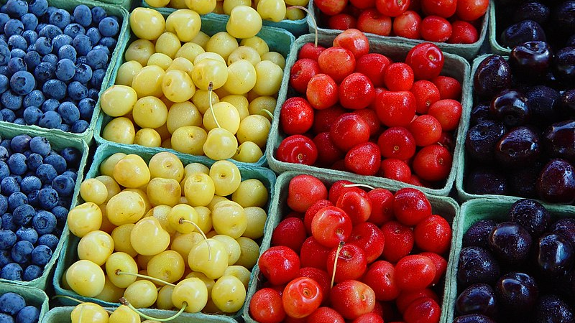
What – Method Type
Variety is the Spice of Life
Notes:
https://commons.wikimedia.org/wiki/File:Variety_is_the_spice_of_life.jpg

Slide 13
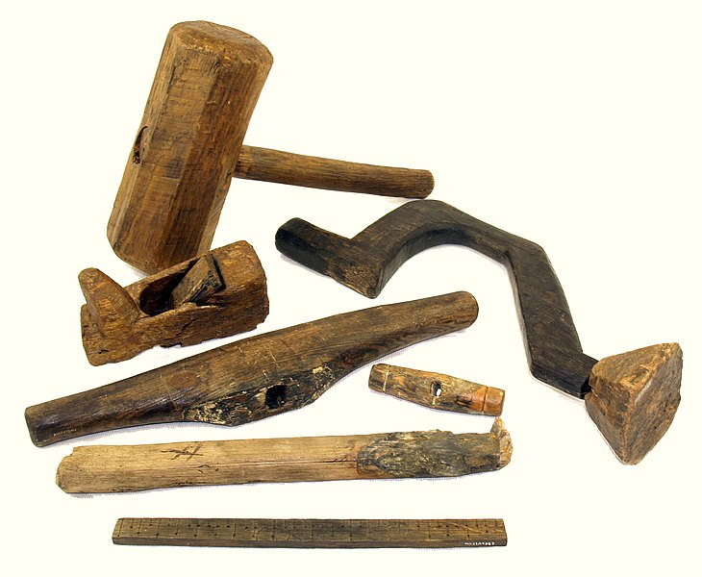

Instruments & Equipment & Tools
Brand/source if it makes a difference
YES - Computer programs for data analysis
NO - programs for data presentation
Notes:
https://commons.wikimedia.org/wiki/File:MaryRose-carpentry_tools1.jpg

Slide 14
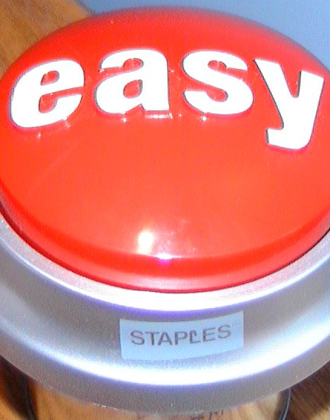
How
Make it easy for your readers!
Cite the original/most complete/most accurate description.
Don’t cite methods that don’t have details.
Ensure your method is actually the same as cited method
If you made many or critical updates just describe your method in detail.
Notes:
https://commons.wikimedia.org/wiki/File:Easy_button.JPG

Slide 15
How – Standard Language
“As previously described in [ref].”
“Briefly, … [ref].”
“Following manufacturer’s instructions”
“with the following modifications: …”
“kindly provided by”
“generous gift from”

Slide 16
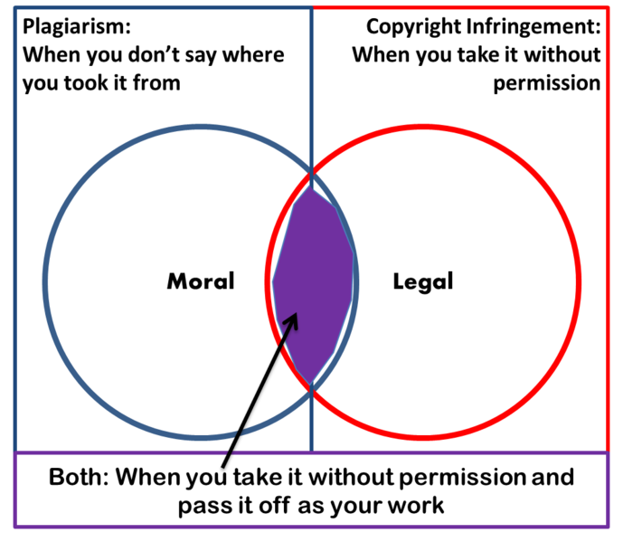
Worries

Slide 17
Examples
You found your drug stuck to polystyrene tubes but not to polypropylene tubes.
You used a scruff holding method for mice during treatment.
You found your mice fail to breed with recycled paper litter but breed well with Oregon pine litter.
Survey was given between 2 and 4 pm.

Slide 18
Workshop: Methods at 3 Levels
Find a detailed protocol (description of methods) for your research.
protocols.io
Write a “medium” detail Methods, 1-2 paragraphs, allows reader to understand results
Write a “low” detail Methods summary, 1-3 sentences, describes approach/establish credibility

Slide 19
Small Group: Introduction Dissections
Label the following elements:
(1a) general context of the work;
(1b) narrower research area, and its importance;
(2a) identification of knowledge gap;
(2b) specific research question to close that gap;
(3a) summary of approach to answer the research question.

Slide 20
Assignment – Due 6/27
Revising
Writing
Title
Abstract
Introduction
Methods

